Slide 1

is one of the most powerful things the world has to offer. No matter what race or religion or nationality or gender that you are, it has the power to unite us.
Lady Gaga
GROUP 7

Slide 2

PROJECT OBJECTIVE
BUILD an NLP MODEL that takes the lyrics of a song and plots return findings that
Provide insights which can potentially tell the GENRE, CONTENT and SETTING of the
song even without listening to the song.

Slide 3

WHY THIS TOPIC? PROBLEM DOMAIN.
MUSIC THERAPY is the use of music to address the physical, emotional, cognitive, and social needs of a group or individual.
POSITIVES Music therapy can help decrease your pain, anxiety, fatigue and depression.
SIDE EFFECTS Particular types of music might irritate some people or make them feel uncomfortable. The music might trigger strong reactions or evoke memories which could range from pleasant to painful.

Slide 4
PROCEDURES
A song by Akon, “Beautiful” was scrapped from a website:
'https://www.azlyrics.com/lyrics/akon/beautiful.html’
The data is then saved to a text file called raw_speech.txt
Fundamental NLP tasks is then performed on the data including tokenization, lemmatization, stemming, part of speech tagging, chunking, summarization and others.
The Finding of the dataset are:
COMMON NOUNS likely tells the setting and language of the song
PROPER NOUNS the subject of and center of focus of the song is told by the proper nouns.
VERBS the energy and action likely to be exerted by the song is reflected in the verb.
The top most 10 of each finding is plotted as Word/(Frequency of occurrence) to tell how often a particular POS appears in the sentence and a summary is given which gives an abstract of what the song is about.
The plots gives insights to the user and hence the sentiment of the song.

Slide 5
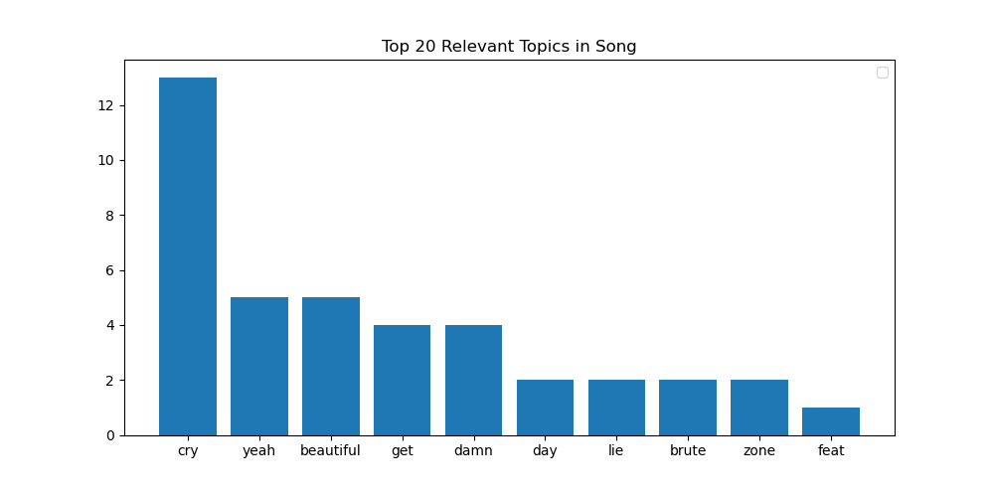
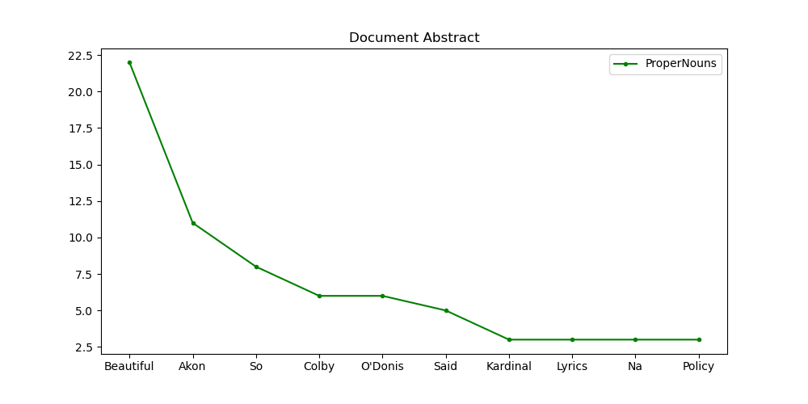
Example of Findings:

Slide 6
PROJECT ILLUSTRATION
The song to be listened to is first passed to the NLP model.
The NLP model produces a list of potential words that are present in the song.
Outcome of Model will tell if it is safe to listen to a song or not depending on lyrics of song.

Slide 7

CHALLENGES FACED
Understanding each single QUESTION was a major problem for the group since almost all are new to this discipline.

Slide 8
TOOLS AND LANGUAGES USED
Tools used:
VsCode
Jupyter notebook (anaconda3)
Languages used:
Python
Fast Api
React
Link to github:
git@github.com:Dept-of-Comp-Sci-University-of-Ghana/coding-assignment---web-scraping-mth-gp-7.git

Slide 9
THANK YOU
NAME | ID
Osro-Agbo Raphael Djangmah | 10827454
Allotey Louis | 10820313
Richmond Martey | 10826913
Nana Krofua Mensah Onumah | 10831391
Cecil Nii Adjei Klufio | 10820028

